Slide 1
Cloud Networks
CSC2229: Topics in Computer Networks, Winter 2024
Qizhen Zhang

Slide 2
Course Overview
Introduction lecture
Paper discussions
Final project
https://fardatalab.org/courses/csc2229.html

Slide 3
What You Will Learn
Fundamental concepts, design principles, and practices of networking in cloud data centers
Examples of top networking research: classic works that have stood the test of time and recent advances
Hands-on experience of conducting such research
A variety of data center networking topics

Slide 4
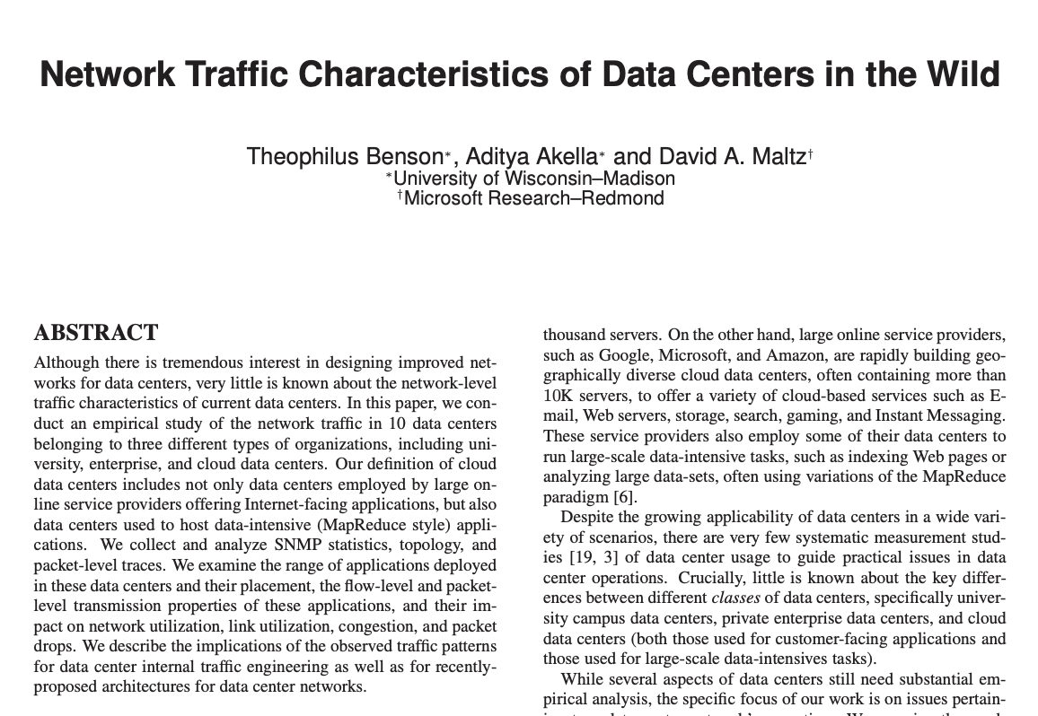
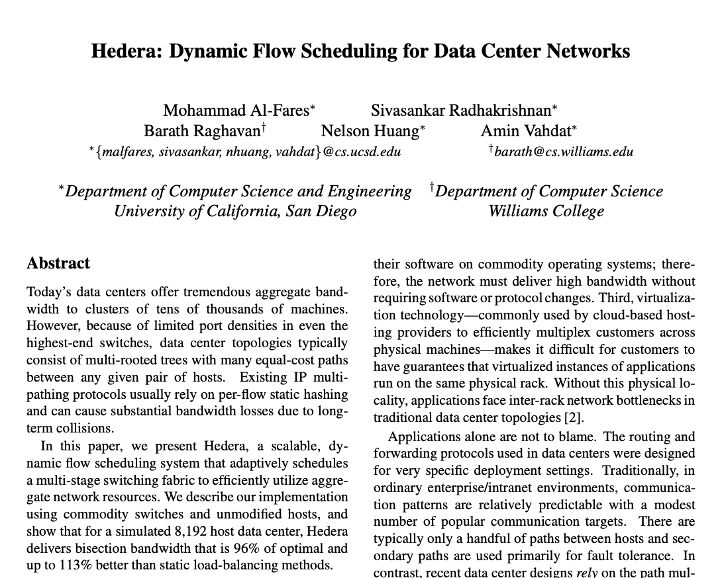
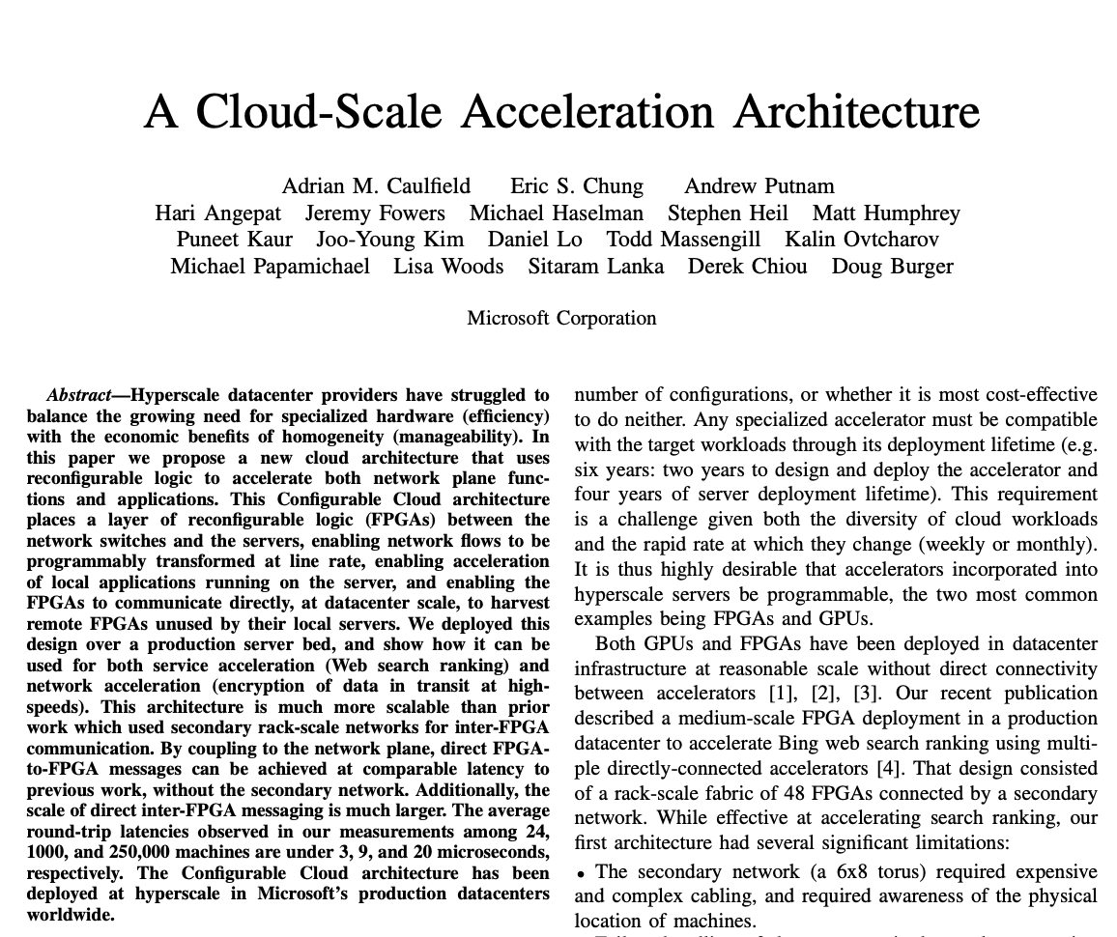
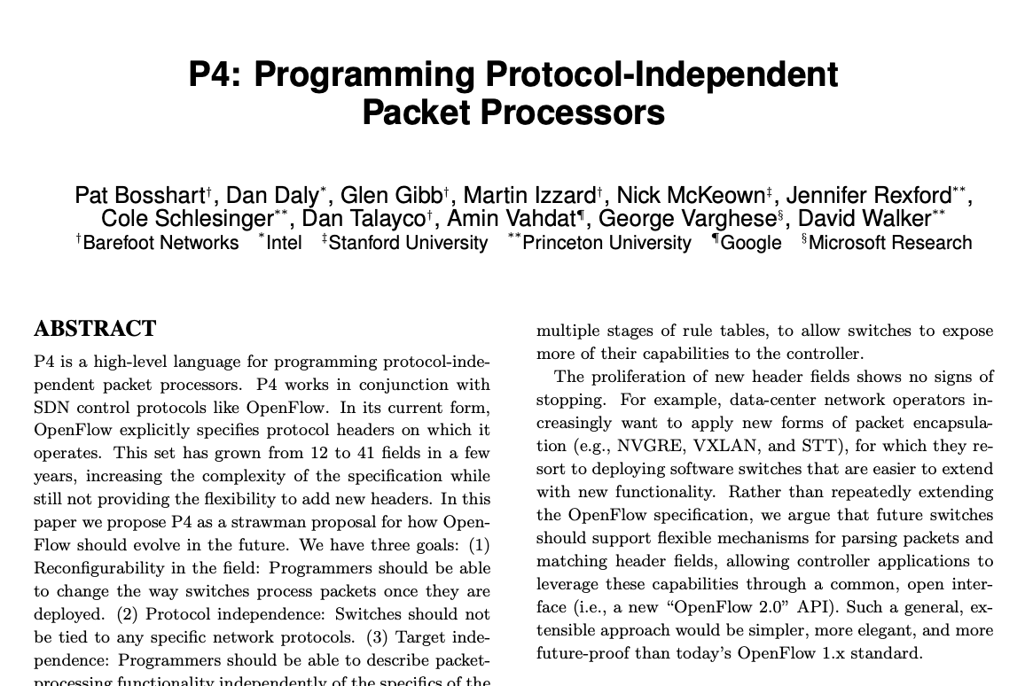
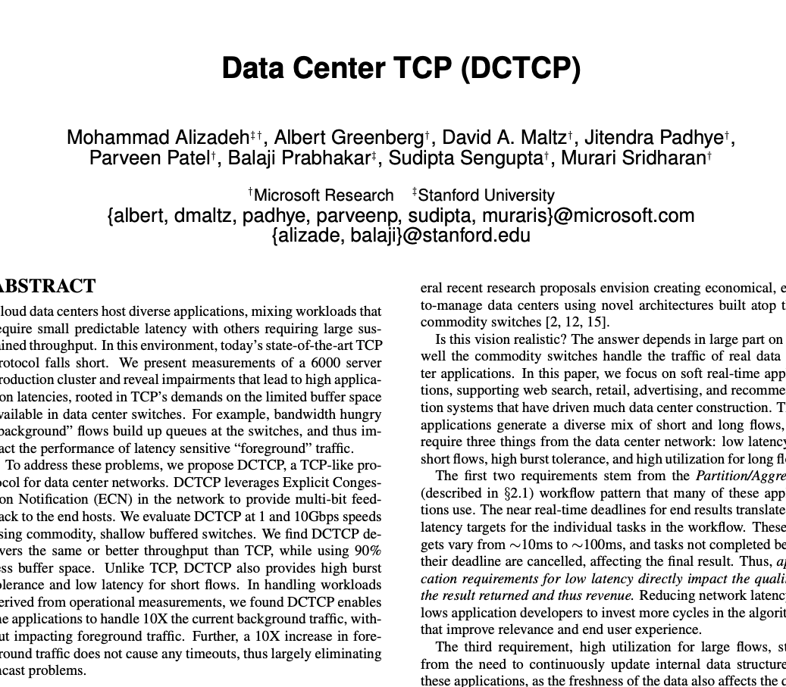
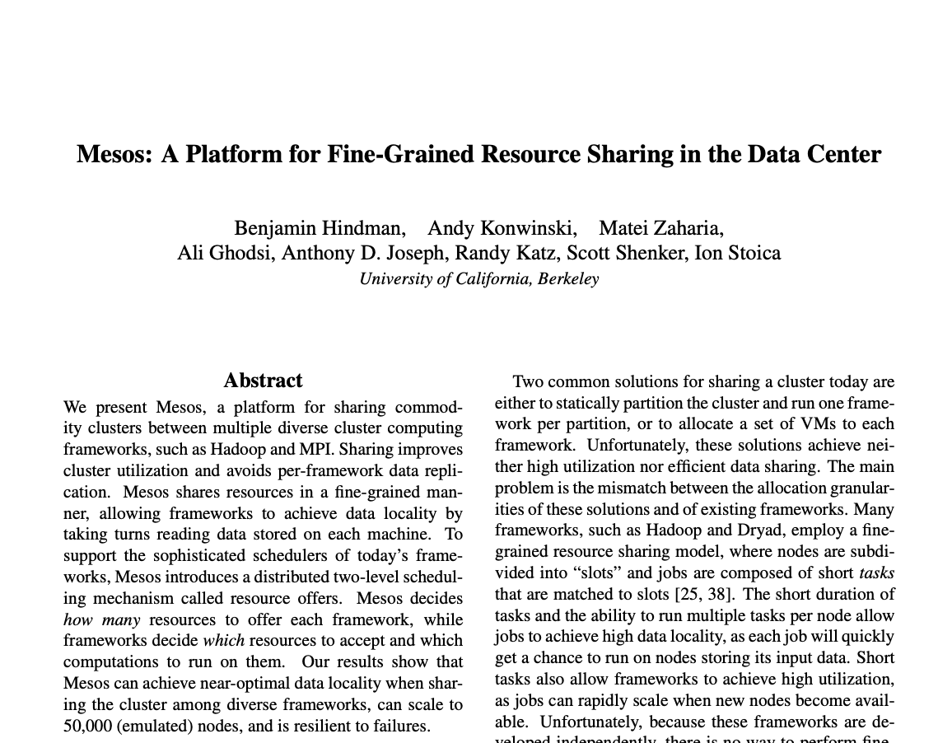
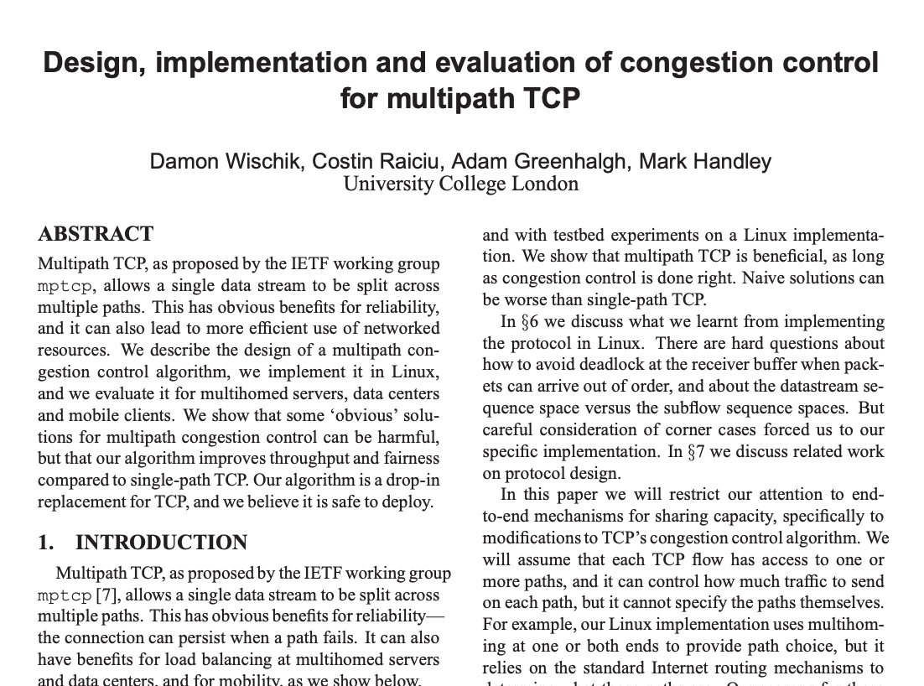
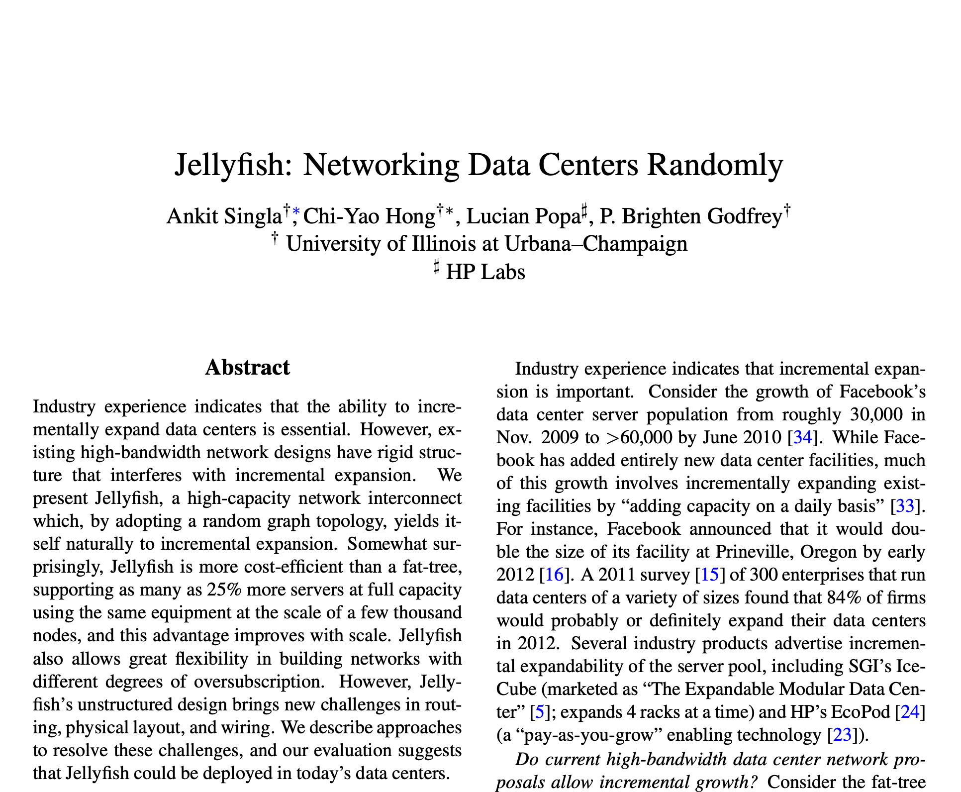
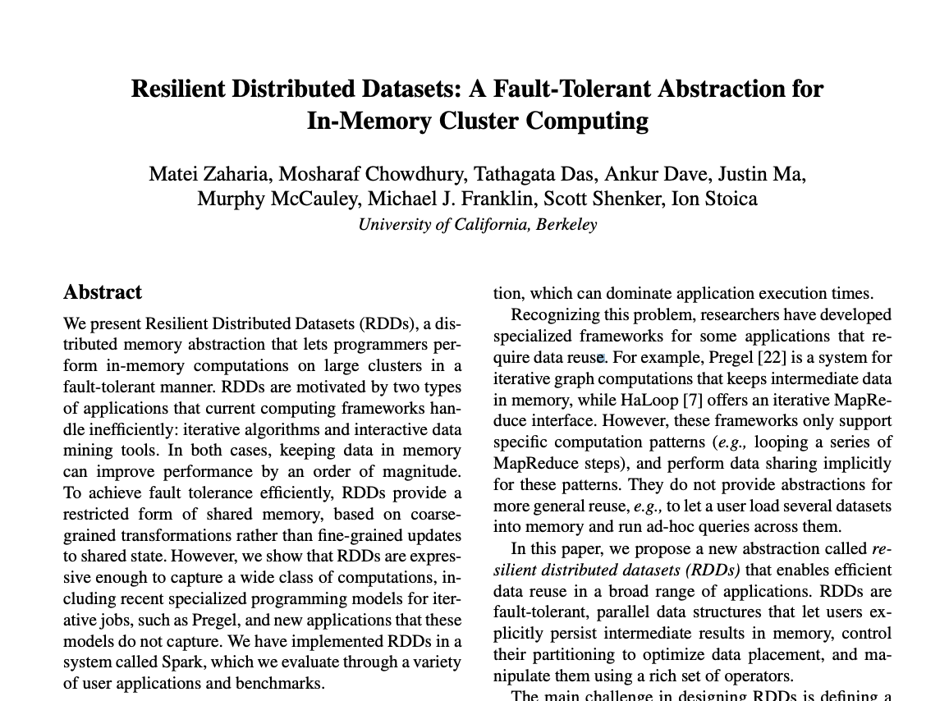
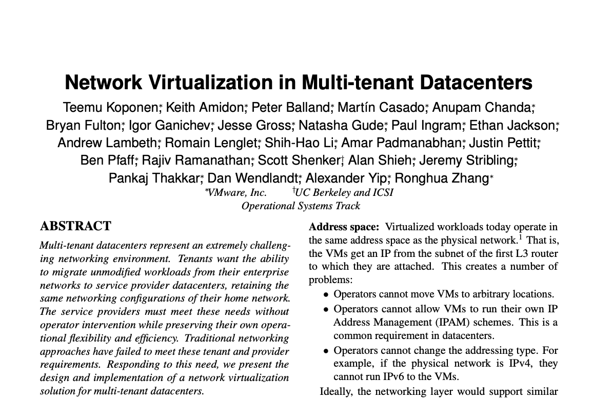
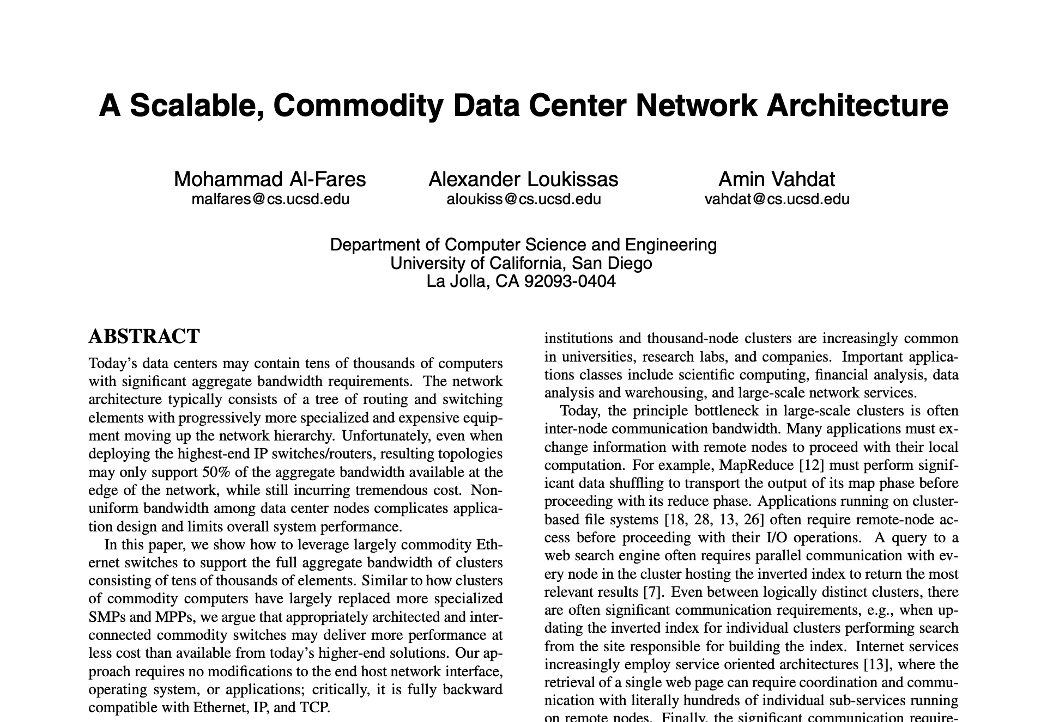
Covered Topics
Load Balancing
Traffic Patterns
Scheduling
Programmable Switches
Congestion Control
Topology
Networks for Accelerators
Distributed Computing
Resource Allocation
Network Architecture
Virtualization

Slide 5
Topics Not Covered (But Relevant)
ML & networking
Wide-area networks
RDMA and disaggregation
SDN
Fault tolerance
Network monitoring
Verification
Modeling and simulation…

Slide 6
Grading
Reading and participation: 50%
Paper reviewing: 20%
Leading discussions: 15%
Participation: 15%
Final project: 50%
Proposal: 10%
Presentation: 20%
Report: 20%

Slide 7
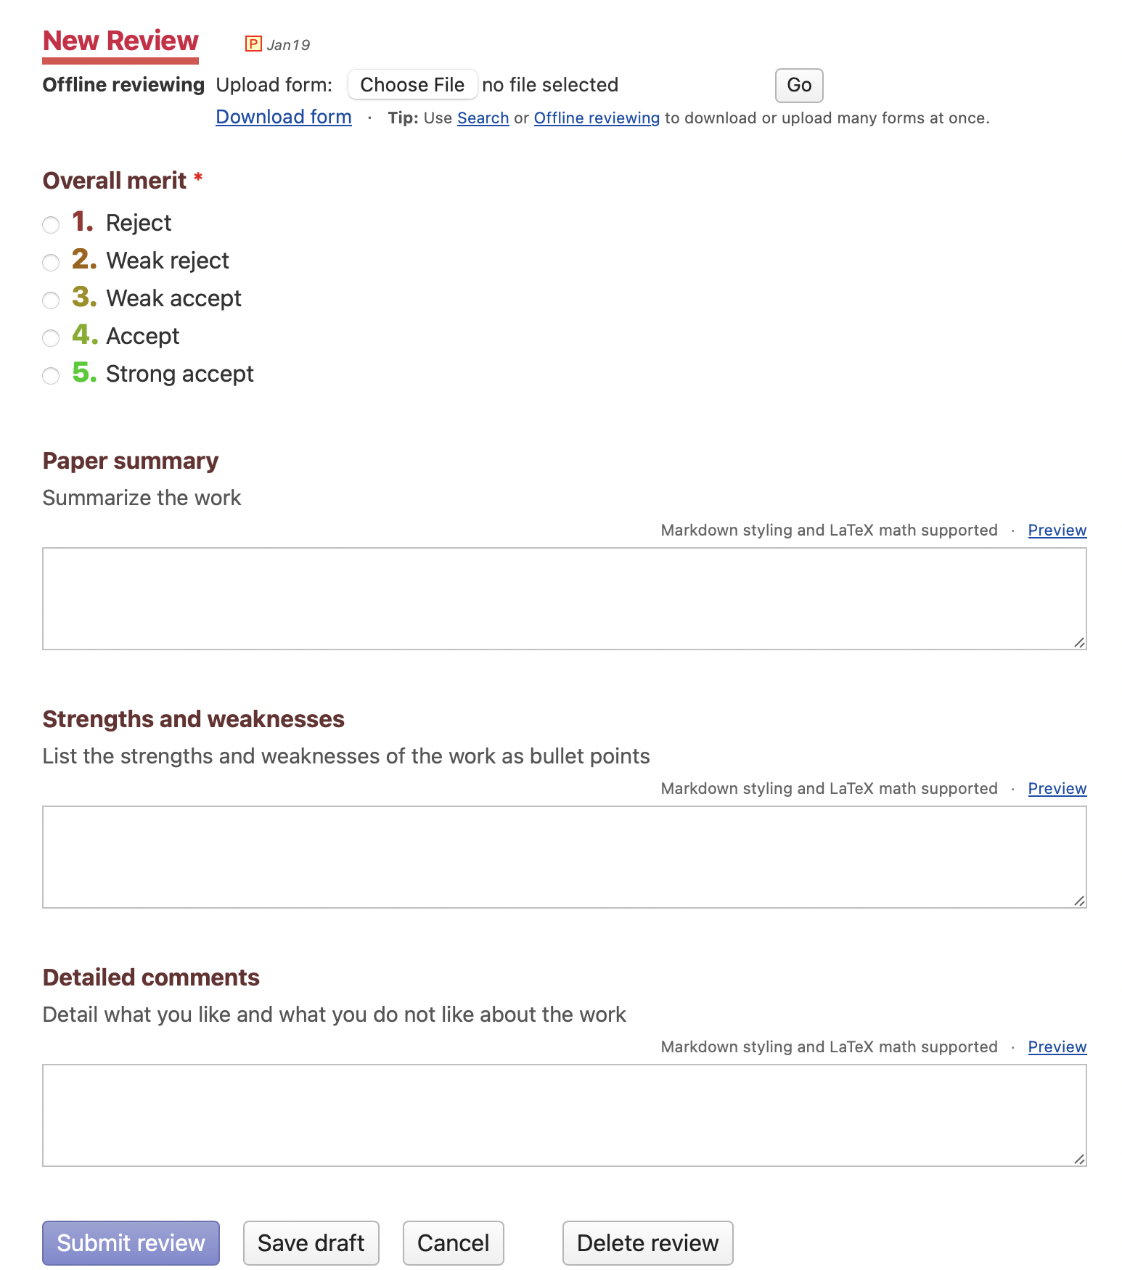
Paper Reviewing
Two papers (classic + recent) on the same topic each week
Before Friday 12 AM, submit your reviews for both papers on HotCrp: https://toronto-net24w.hotcrp.com
You are allowed to skip the reviews of two papers

Slide 8
Leading Discussion
For each paper, two students will present the work and lead the discussion from opposite sides (from Jan. 26)
Advocator: 10 min introducing the work + 20 min defending the work
Adversary: 20 min attacking the work
Every student serves as the advocator for one paper and the adversary for another (send me slides after each class)

Slide 9
Participation
Join discussion any time during the class
Say something not in the paper
Vote for one side at the end of a paper discussion

Slide 10
Final Project
Research a specific topic related to cloud computing and data center networks
Teamwork (2-3 students per team): a 1-page proposal, a 6-page report, and a 25-minute presentation
How to execute the project
Reproduce existing work (80% reproduction + 20% innovation)
Develop your own ideas (50% design + 50% realization)

Slide 11
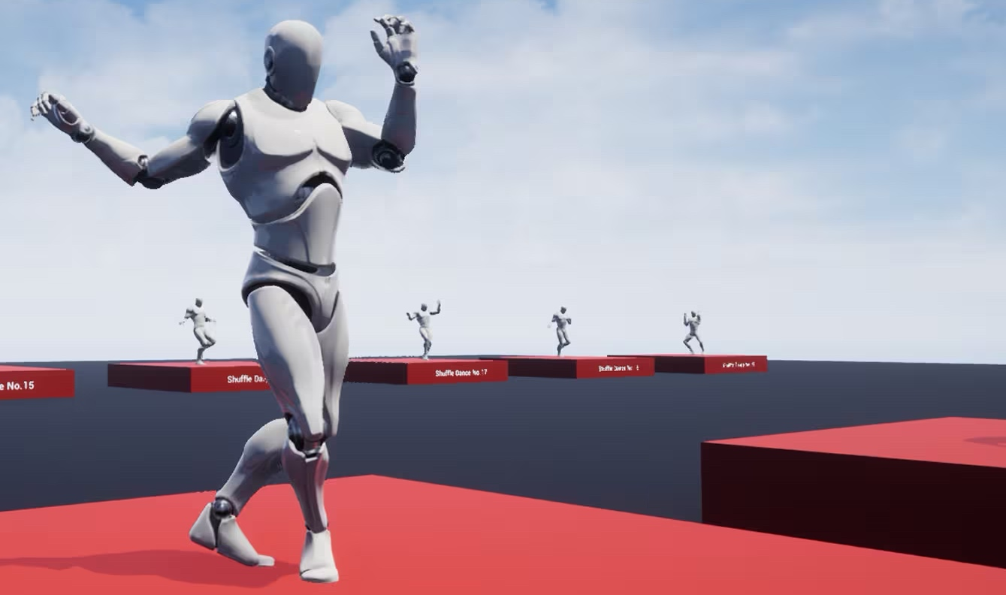
This Year's Topic
Shuffle
A critical communication primitive
Databases, MapReduce, ML…
Any perspective of shuffling in cloud data centers
Background materials on Quercus

Slide 12
Development
System implementation and evaluation are an integral part
60%+ of the mark for reproduction
50% of the mark for new proposals
CloudLab: https://cloudlab.us
An academic cloud where you get physical machines and network
Register an account and request to join the csc2229 project

Slide 13
Deadlines
Jan. 14
Jan. 19
Feb. 9
Apr. 26
Register a HotCrp account and fill the info on Google Sheets
Sign up for leading discussions on the Google Sheets
Form team and put names on the Google Sheets
Submit project proposal on Quercus
Sign up for the final presentation on Google Sheets
Submit project report on Quercus

Slide 14
Questions?
Office hours: Wednesday 9 AM – 10 AM on Zoom
Piazza (link and access on Quercus)

Slide 15
Introduction to Cloud Networks
*Incorporates lectures by Vincent Liu and Mohammad Alizadeh

Slide 16
Cloud Computing Is Everywhere

Slide 17
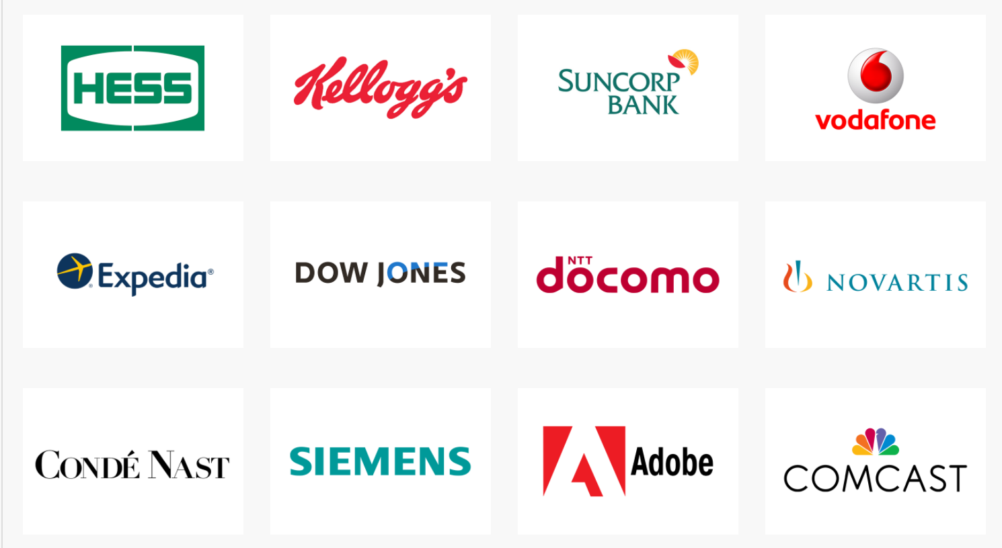
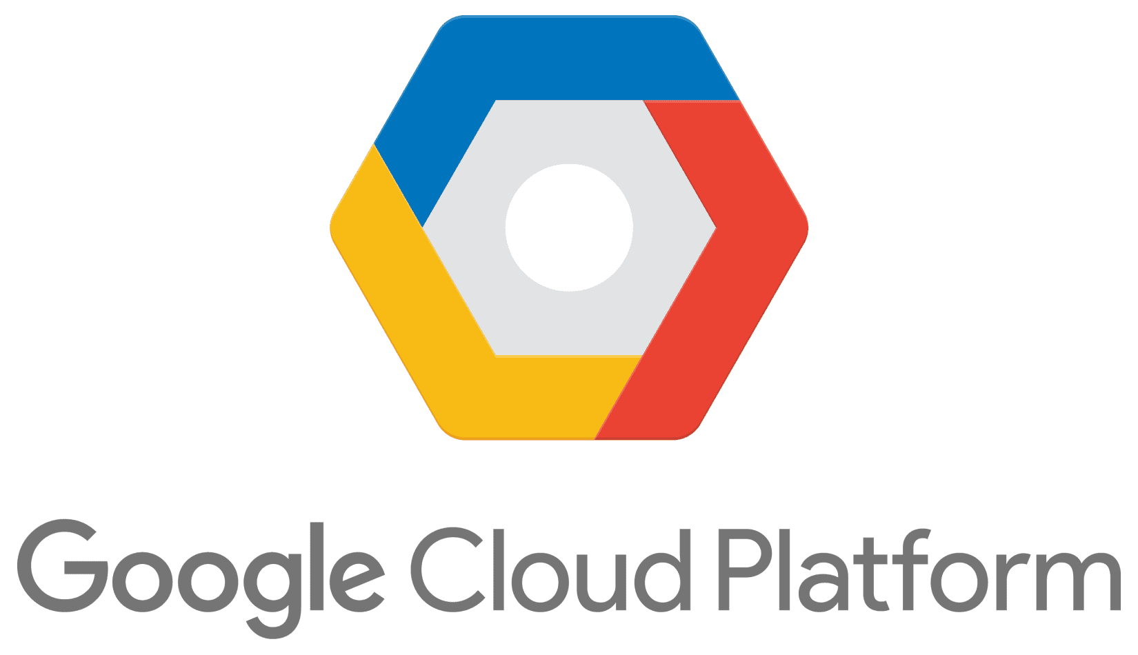
Cloud Computing Is Everywhere

Slide 18
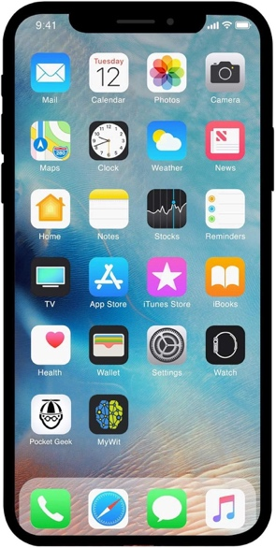
What Is Cloud Computing
Internet
Client
Server

Slide 19
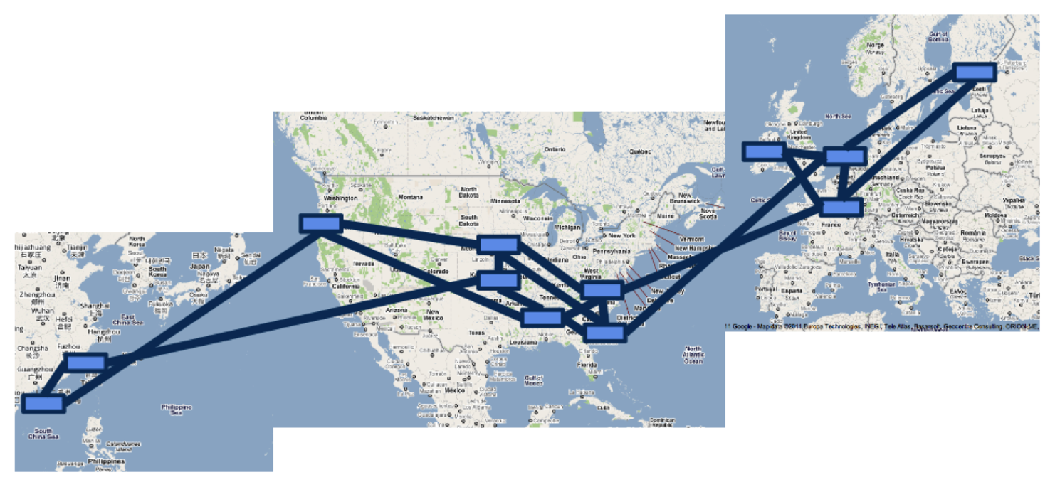
What Is Cloud Computing
Internet
Client

Slide 20
What Is Cloud Computing
Cloud computing is the on-demand availability of computing resources (such as storage and infrastructure), as services over the internet.
It eliminates the need for individuals and businesses to self-manage physical resources themselves, and only pay for what they use.
⏤ Google

Slide 21
Cloud Computing Benefits
Elasticity
Scale up & down based on demand

Slide 22
Cloud Computing Benefits
Elasticity
Multi-tenancy
Multiple independent users share infrastructure
Security and resource isolation
SLAs on performance and reliability

Slide 23
Cloud Computing Benefits
Elasticity
Multi-tenancy
Centralized & dynamic management
Resiliency: isolate failure of servers and storage
Workload movement: move work to other locations

Slide 24
Cloud Computing Benefits
Elasticity
Multi-tenancy
Dynamic management
Economies of scale
Lower hardware and operational cost
Faster hardware iteration and transparent deployment

Slide 25
Cloud Service Models
Software as a Service (SaaS)
Provides completed applications
E.g., customer relationship management, e-mail, and chat
Avoids costs of installation, maintenance, and patches

Slide 26
Cloud Service Models
Software as a Service (SaaS)
Platform as a Service (PaaS)
Offers platform for building applications
E.g., Google's App-Engine
Avoids worrying about scalability of platform

Slide 27
Cloud Service Models
Software as a Service (SaaS)
Platform as a Service (PaaS)
Infrastructure as a Service (IaaS)
Offers raw computing, storage, and network
E.g., Amazon's Elastic Computing Cloud (EC2)
Avoids buying servers and planning resource needs

Slide 28
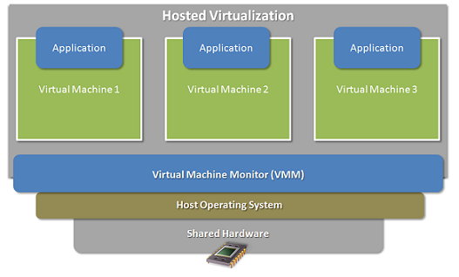
Enabling Technology: Virtualization
Multiple virtual machines on one physical machine
Applications run unmodified as on real machines
VMs can migrate from one computer to another

Slide 29
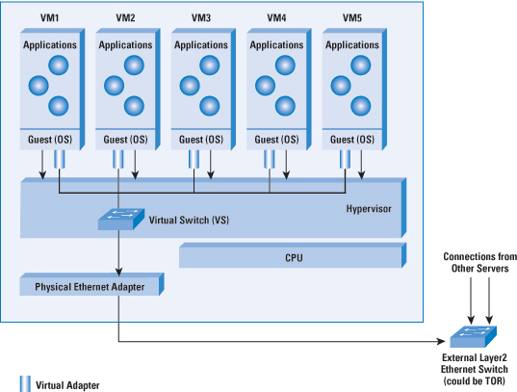
Virtual Switching

Slide 30
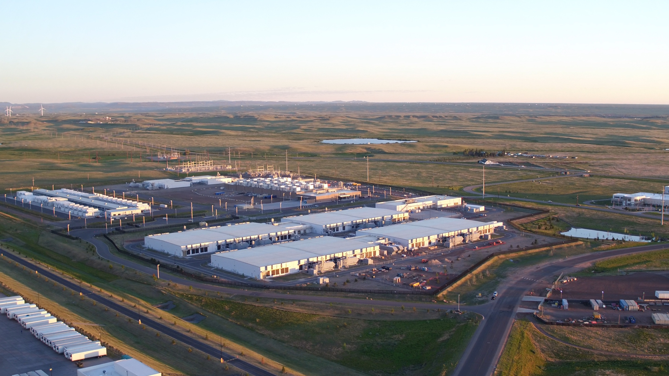
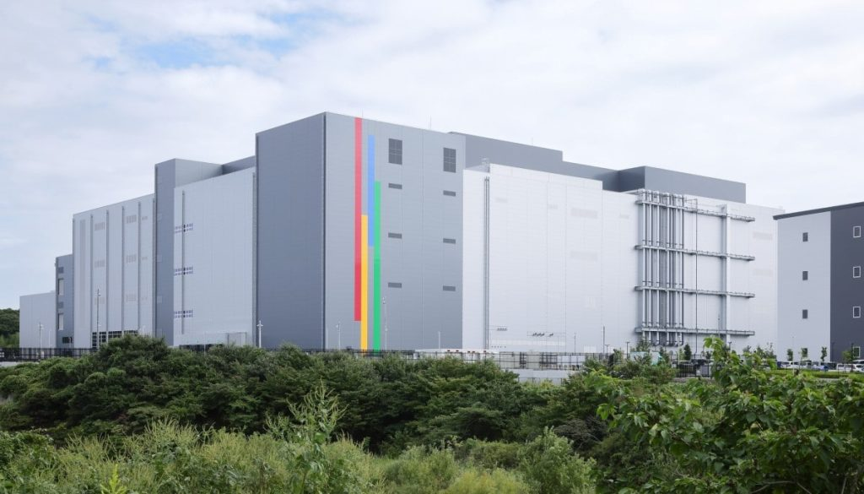
The Result: Data Centers
Microsoft
Google

Slide 31
Data Centers Are Big
10K-100K servers
100s of Petabytes of storage
100s of Terabits/s of Bw
(more than core of Internet)
10-100MW of power
(1-2 % of global energy consumption)
100s of millions of dollars
100 billion searches per month
2 billion daily active users
310 million users

Slide 32
How to Build a Cloud Network

Slide 33
A Lot Of Ground To Cover

Slide 34
How to Build a Data Center Network
Physical Layer

Slide 35
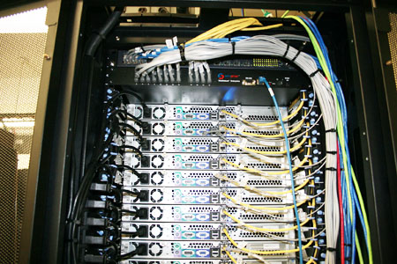
Servers in a Rack
Commodity server blades
A top-of-rack (ToR) switch
Modular design
Preconfigured rack space
Cabling: power, network, and storage

Slide 36
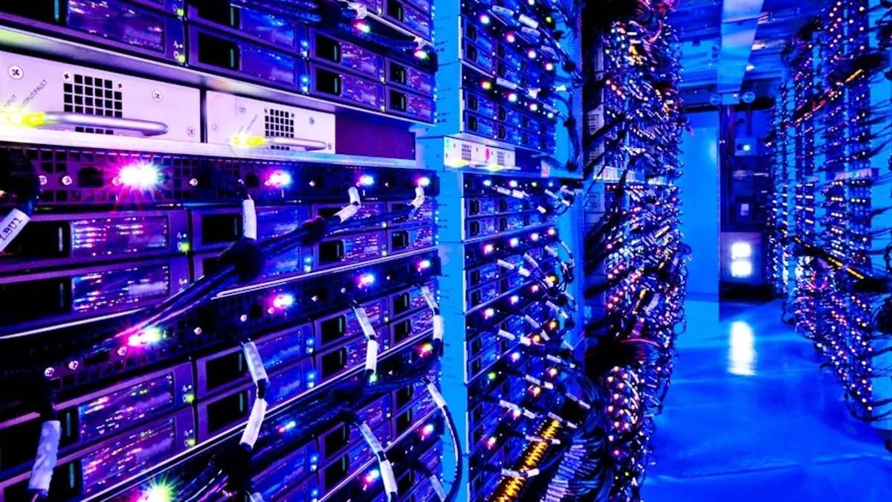
Racks in a Row

Slide 37
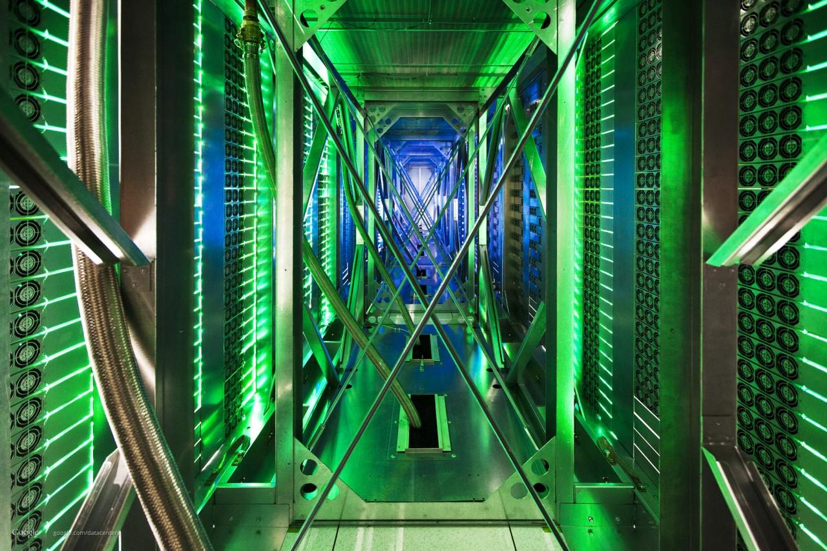
Rows in a Hot/Cold Pair

Slide 38
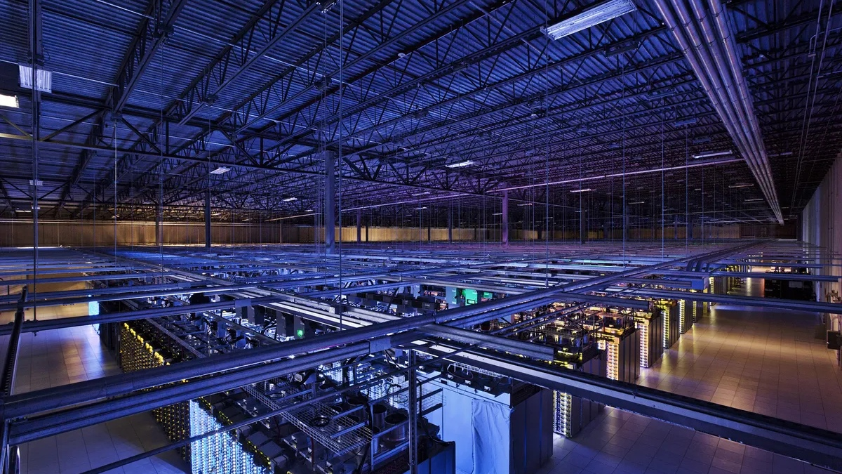
Hot/Cold Pairs in a Data Center

Slide 39
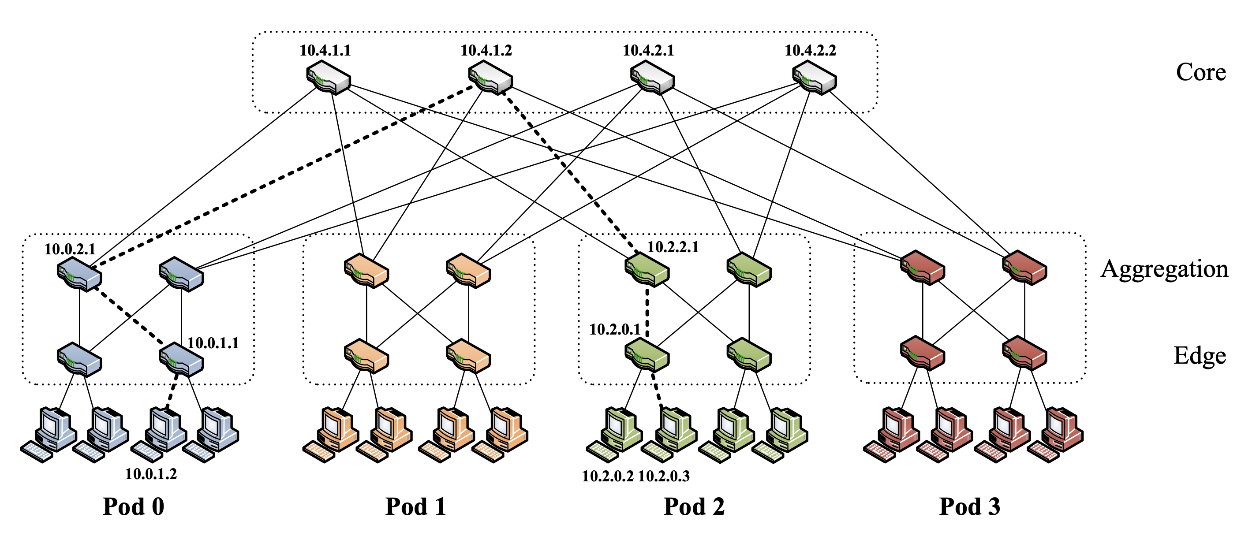
The Data Center Network (Logical)
*From Al-Fares et al.
SIGCOMM's 08

Slide 40
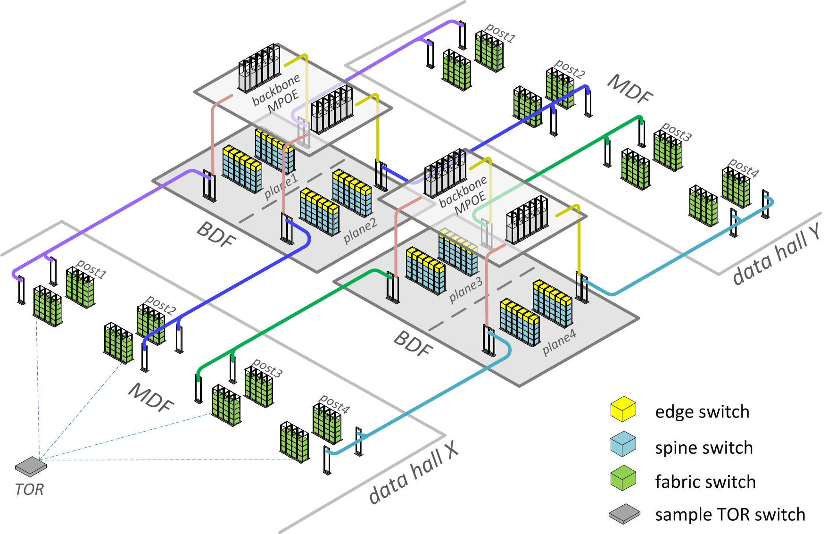
The Data Center Network (Physical)

Slide 41
How to Build a Data Center Network
All The Other Layers

Slide 42
OSI Model
7. Application
4. Transport
Reliable streams OR messages
3. Network
Best effort global packet delivery
2. Data Link
Best effort local packet delivery
1. Physical
How to send bits from A to B

Slide 43
OSI Model
7. Application
4. Transport
TCP/UDP
3. Network
IP
2. Data Link
Ethernet
1. Physical
Copper and optical links

Slide 44
L2: Ethernet
MAC addresses (e.g., 00-15-C5-49-04-A9 from Dell)
Unique, hard-coded in the adapter when it is built
Flat name space of 48 bits
Single shared broadcast channel (i.e., not switched)
Preamble
(7B)
SFD
(1B)
Dst address
(6B)
Src address
(6B)
Length
(2B)
Data
(46-1500 B)
CRC
(4B)
Not scalable

Slide 45
L3: Internet Protocol (IP)
IP addresses
Addresses are assigned and can be changed
Hierarchical addressing, as opposed to flat
Hop-by-hop packet routing
Each router has a forwarding table
Maps destination address to outgoing interface
Upon receiving a packet
Inspect the destination address in the header
Index into the table
Determine the outgoing interface
Forward the packet out via that interface
Then, the next router in the path repeats

Slide 46
L4: User Datagram Protocol (UDP)
Datagram messaging service
Demultiplexing: port numbers
Detecting corruption: checksum
Lightweight communication between processes
Send and receive messages
Avoid overhead of ordered, reliable delivery

Slide 47
L4: Transmission Control Proto. (TCP)
Stream-of-bytes service
Sends and receives a stream of bytes
Reliable, in-order delivery
Corruption: checksums
Detect loss/reordering: sequence numbers
Reliable delivery: acknowledgments and retransmissions
Connection oriented
Explicit set-up and tear-down of TCP connection

Slide 48
L4: Transmission Control Proto. (TCP)
Flow control
Prevent overflow of the receiver's buffer space
Congestion control
Adapt to network congestion for the greater good

Slide 49
What's Different about DCNs?
Single administrative domain
No need to be compatible with outside world
Tiny round trip times (microseconds)
Latency/tail latency critical
Massive multipath topologies
Shallow buffers
Backplane for large-scale parallel computation

Slide 50
Data Center Challenges
Massive bisection bandwidth
Architectures and topologies
Load balancing
Optics
Ultra-Low latency (single-digit microseconds)
Rate-control or packet scheduling?
Centralized or distributed?
Managing resources across network & servers
Multi-tenant performance isolation
App-aware network scheduling (e.g. for big data)
Next-generation hardware
RDMA, disaggregation, hardware acceleration…

Slide 51
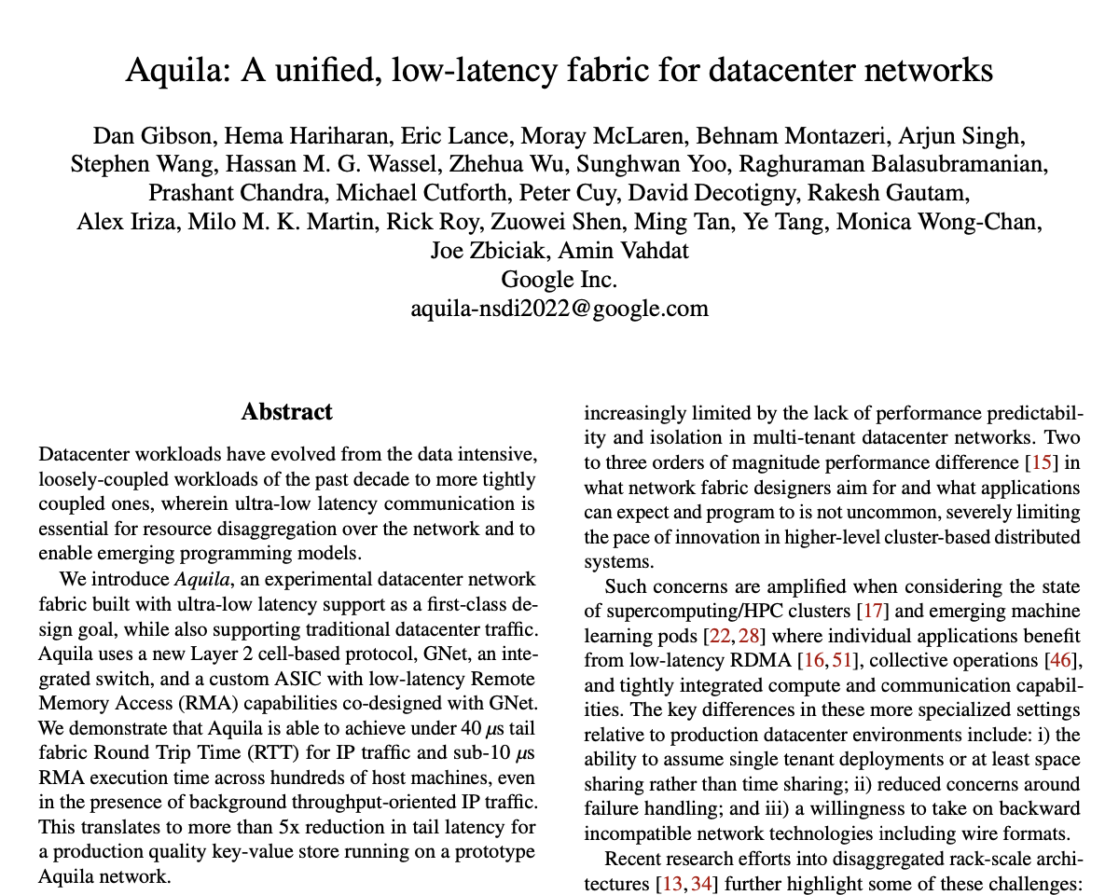
For Next Time..

